Slide 1
Southern Hudson Bay Polar Bear Management
System -- Sanikiluaq, Nunavut
For
Nunavut Wildlife Management Board Public Hearing on Nunavut Polar Bear Management Plan
Sanikiluaq Hunters & Trappers

Slide 2
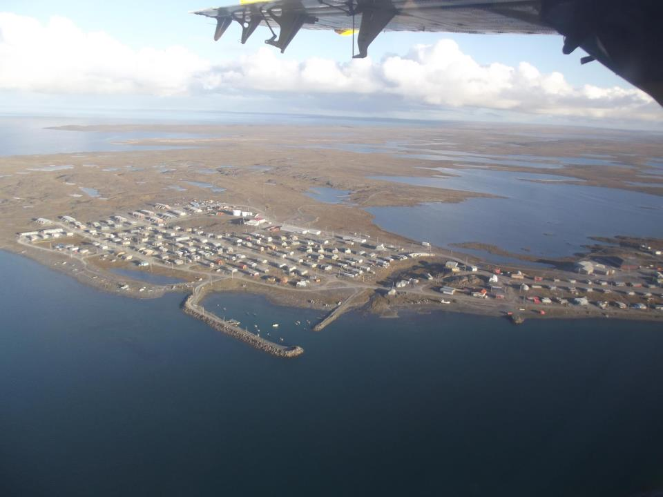
SHB Polar Bear Management System Nunavut
Sanikiluaq, Nunavut
Current population 882 (2016)
The community has used a quota system for over 40 years
Since 2005, the community has used the MOU which includes a flexible quota system and sex ratio

Slide 3
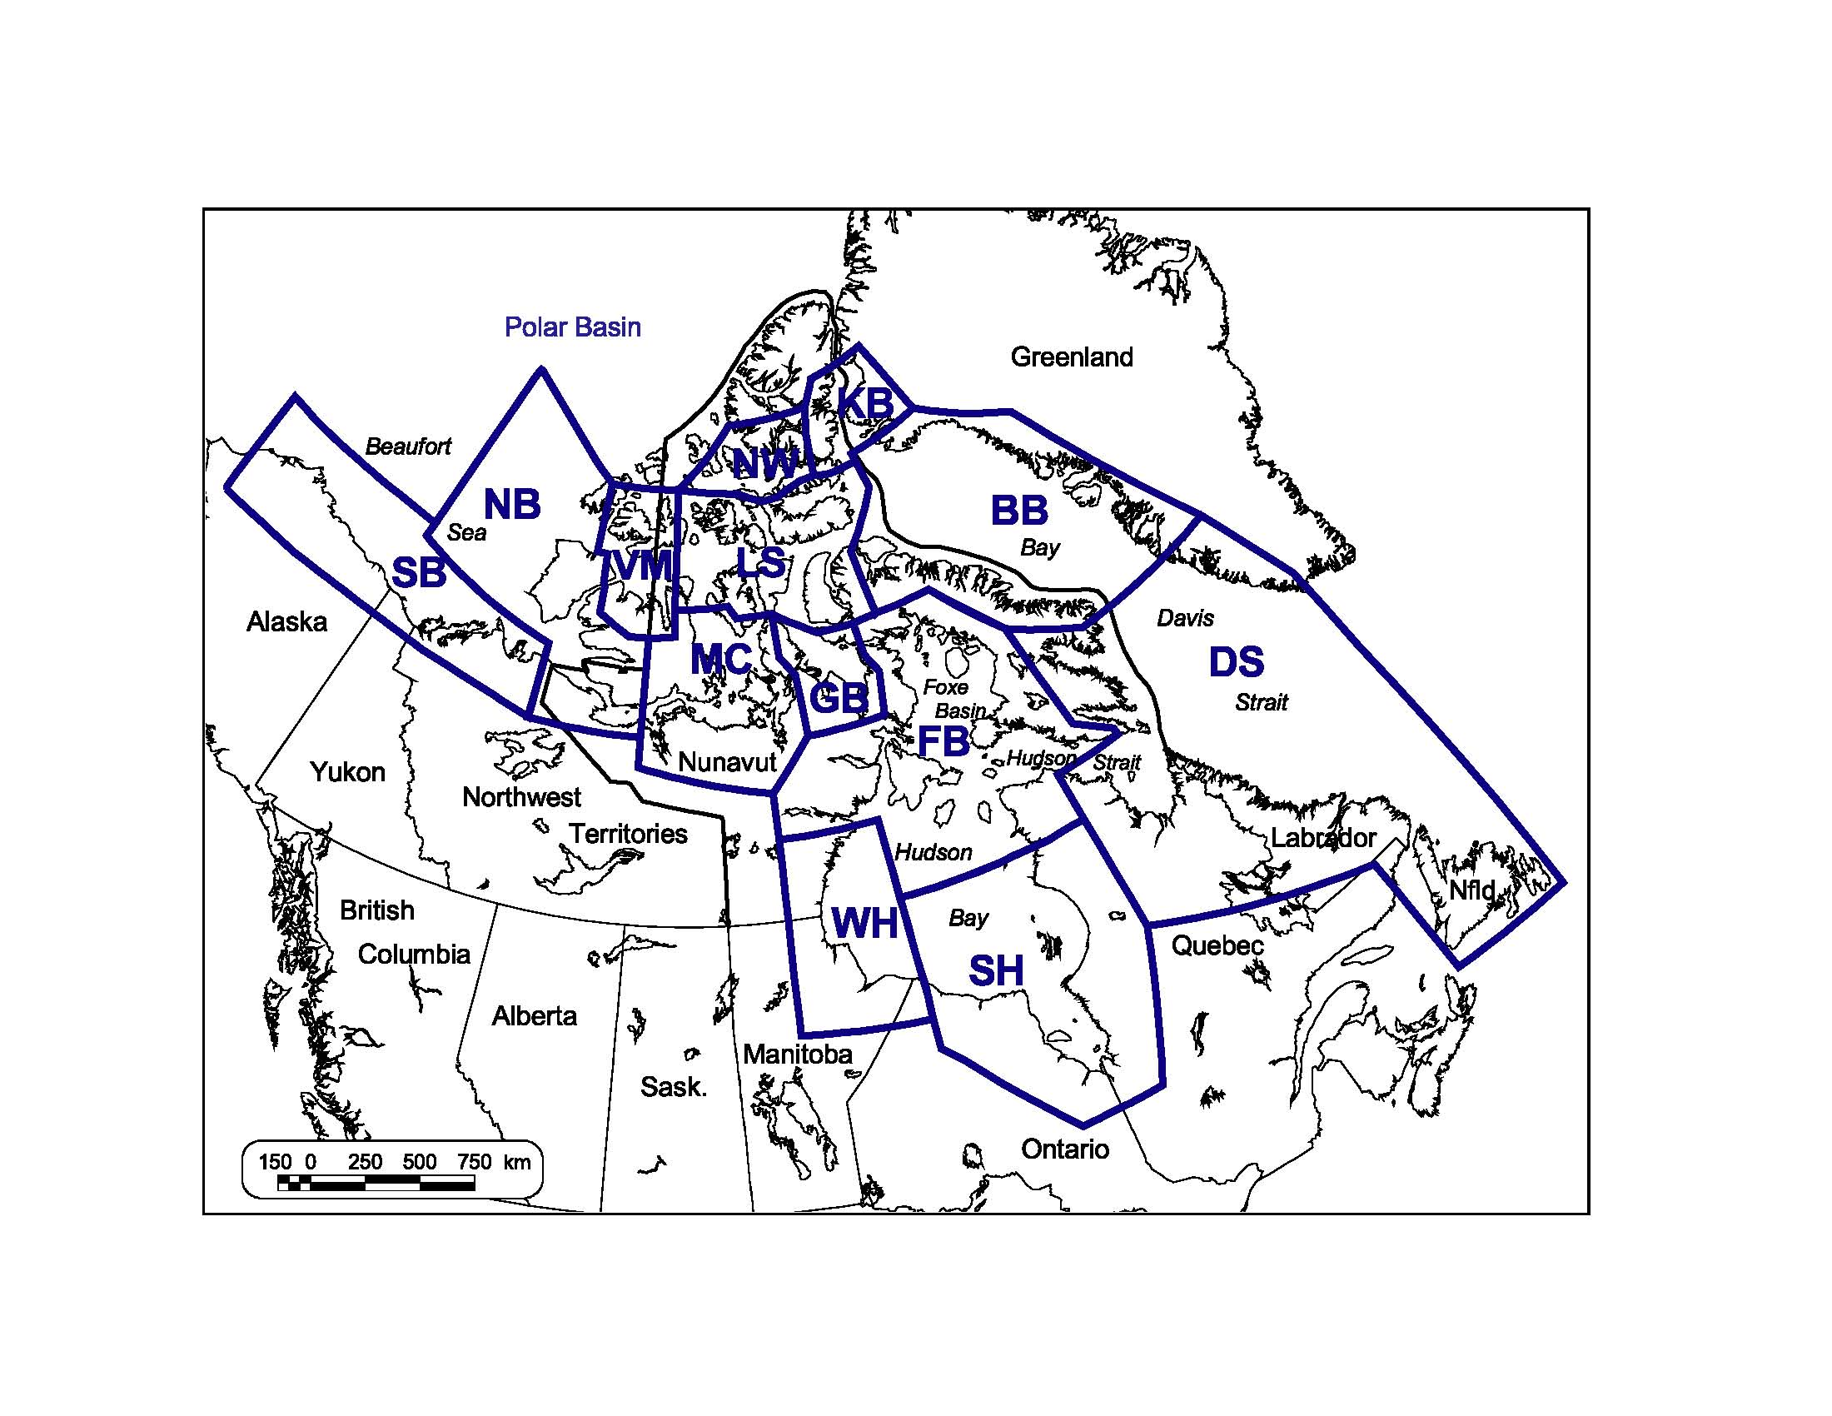
SHB Polar Bear Management System Nunavut
Since 2005, Sanikiluaq has been using the flexible quota system.
This system is based on the Memorandum of Understanding (MOU) between Sanikiluaq and the Government of Nunavut.
The community has followed the flexible quota system for the past 11 years. Its purpose is to conserve the population and maintain a sustainable harvest level.

Slide 4
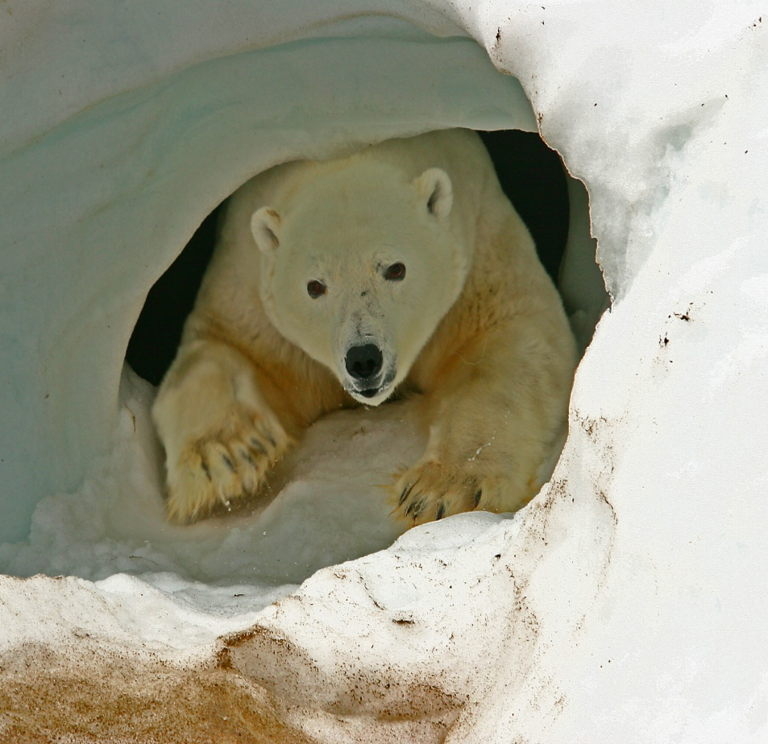
SHB Polar Bear Management System Nunavut
The system also prohibits harvest of family groups, bears in dens, or cubs.
However, for cultural reasons, a cub can be harvested through a request to the Government of Nunavut.
The sex selective system means that one female can be harvested for every two males that are harvested.
The community has been following this system and has not expressed any concerns

Slide 5
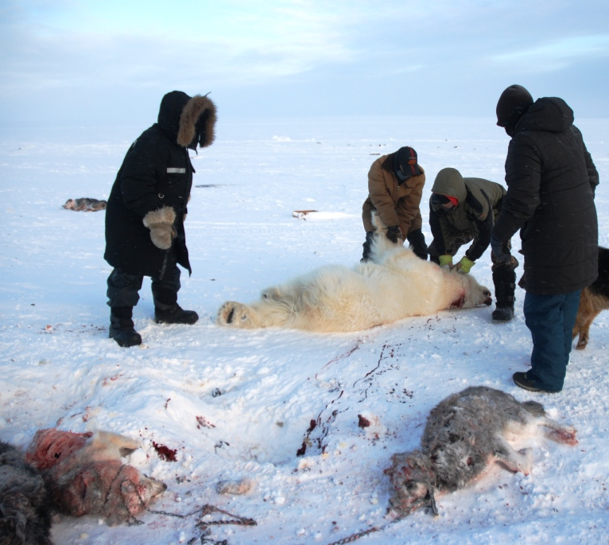
SHB Polar Bear Management System Nunavut
Under the system, every person in Nunavut has the right to protect life and property.

Slide 6
Sustainable Harvest Management
HARVEST SEASON | TOTAL ALLOWABLE HARVEST (TAH) | ACTUAL HARVEST
2005/2006 | 25 (17 Males: 8 Females) | 25 (16 Males: 9 Females)
2006/2007 | 25 (17 Males: 8 Females) | 25 (17 Males: 8 Females)
2007/2008 | 25 (17 Males: 8 Females) | 25 (18 Males: 7 Females)
2008/2009 | 25 (17 Males: 8 Females) | 26 (18 Males: 8 Females)
2009/2010 | 25 (17 Males: 8 Females) | 25 (17 Males: 8 Females)
2010/2011 | 25 (17 Males: 8 Females) | 30 (21 Males: 9 Females)
2011/2012 | 25 (17 Males: 8 Females) | 25 (17 Males: 8 Females)
2012/2013 | 25 (17 Males: 8 Females) | 26 (22 Males: 4 Females)
2013/2014 | 25 (17 Males: 8 Females) | 27 (17 Males: 10 Females)
2014/2015 | 25 (17 Males: 8 Females) | 20 (14 Males: 6 Females)
2015/2016 | 25 (17 Males: 8 Females) | 20 (14 Males: 6 Females)
2016/2017 | 25 (17 Males: 8 Females) | 20 (13 Males: 7 Females)
Totals | 300 (204 Males: 96 Females) | 294 (204 Males: 90 Females)
Over this period, the community has harvested bears within the total allowable harvest and also maintained a 2:1 male to female sex ratio harvest.
In some years, the community has used credits accumulated from unused harvest from previous years as permitted through the flexible quota system
Since 2014, the community has respected a user to user agreement

Slide 7
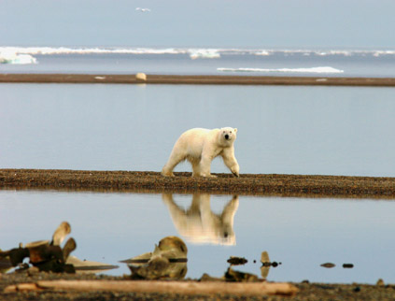
SHB Polar Bear Management System Nunavut
Sanikiluaq HTO has requested credits that they have accumulated from unused harvest in previous years.
This is part of the flexible quota system currently in place.
The community of Sanikiluaq has successfully adopted and used this system.

Slide 8
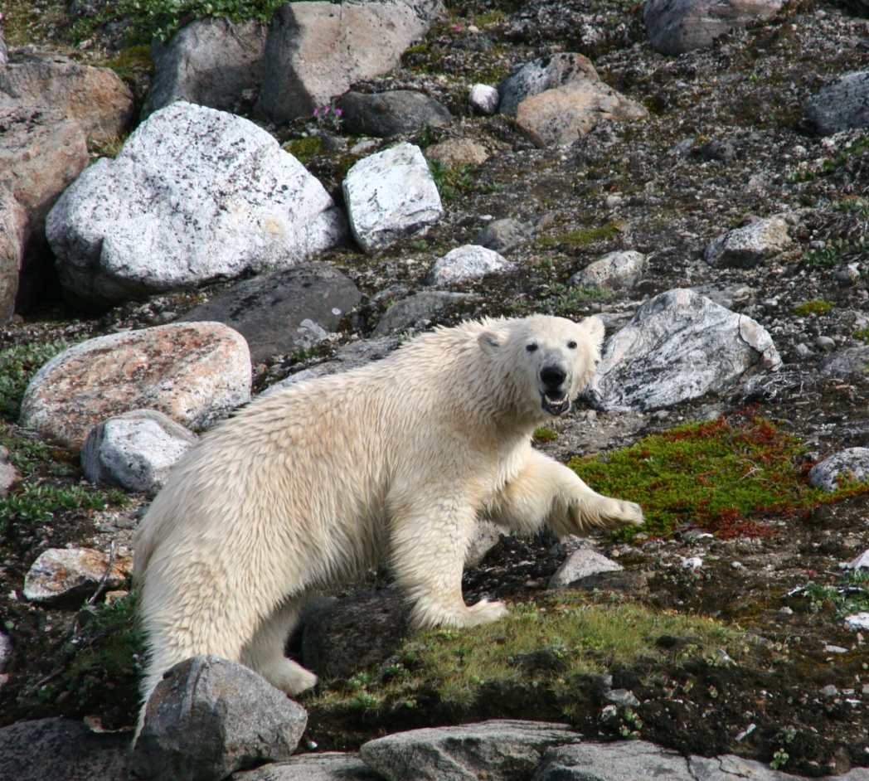
SHB Polar Bear Management System Nunavut
By using the system, the Sanikiluaq HTO has helped conserve the polar bear population, through a sustainable harvest.
The HTO has responsibly and successfully managed the system and polar bear harvest for many years.

Slide 9
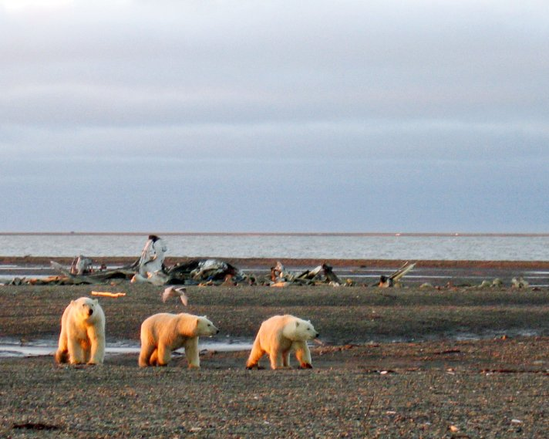
Issues
Some concerns include a high population of polar bears that destroy bird colonies which are not in balance with the environment
Eider ducks are very important part of Sanikiluaqmiut diet
Another concern is encounters with polar bears in the community.
Sanikiluaq HTO has been working on establishing a community bear management plan, which identifies preventative measures and deterrent procedures to protect people and property from bears that come close to the community.
Therefore, harvest remains important not only for cultural reasons but also to maintain bears at numbers that maintain natural balance

Slide 10
SHB Polar Bear Management System Nunavut
Sanikiluaq is an excellent example of how HTO’s in Nunavut conduct responsible harvest practices that are sustainable and respectful of the principles of conservation.
Thank You

