Slide 1
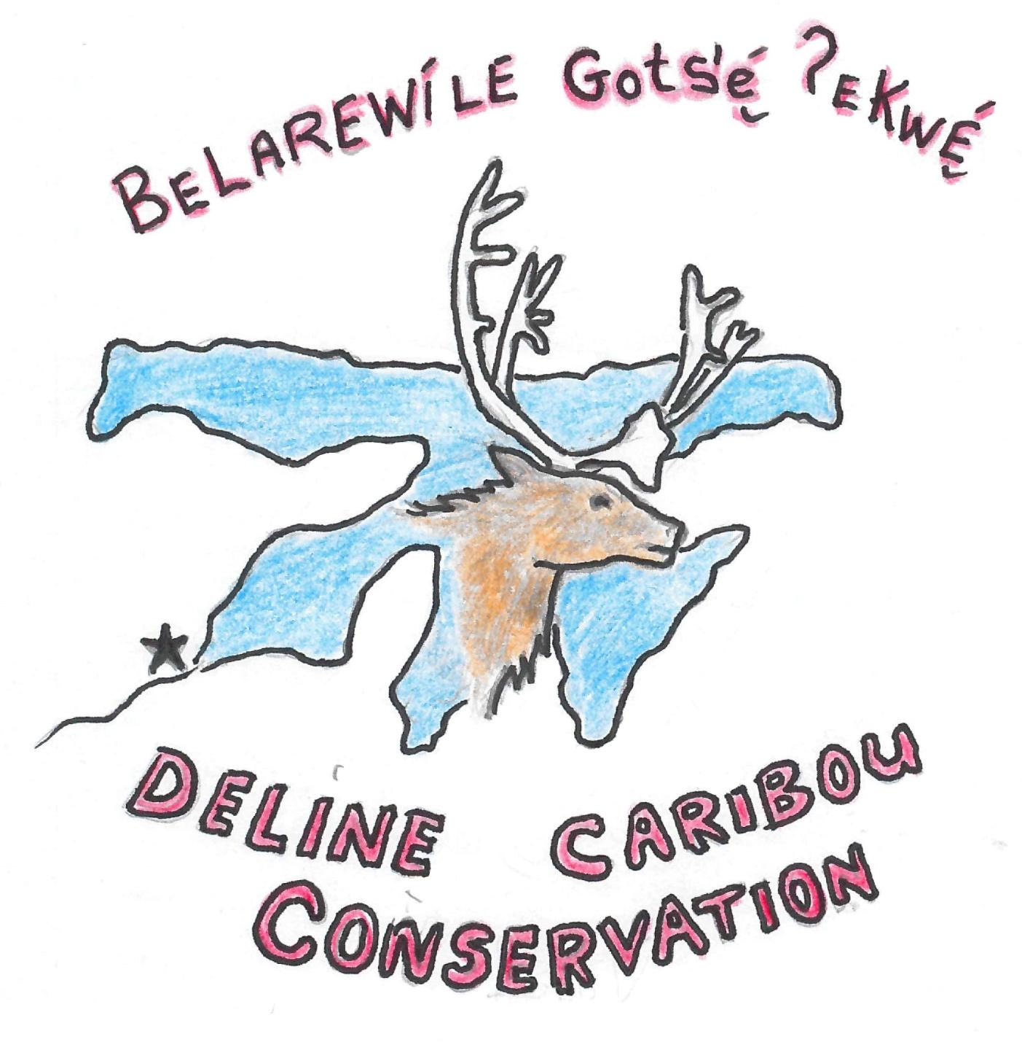
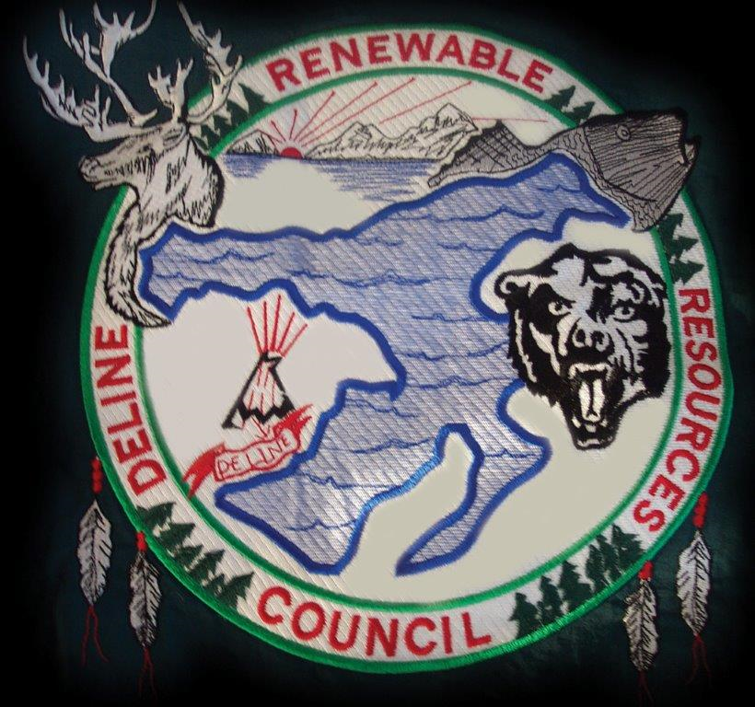

A Délı̨nę Plan for Nı̨regha Ɂekwę́ (Bluenose East Caribou)
Délı̨nę Got’ı̨nę Government
and Délı̨nę Ɂehdzo Got’ı̨nę (Renewable Resources Council)
Nunavut Wildlife Management Board Bluenose East Hearing
March 2-4, 2020, Kugluktuk, NU

Slide 2
Overview
Background: who we are
Nı̨regha Ɂekwę́ abundance
Harvest regulation
Dene náowerǝ́ (knowledge) and principles
Approaches
Frameworks
Moving forward: rebuilding relationships

Slide 3
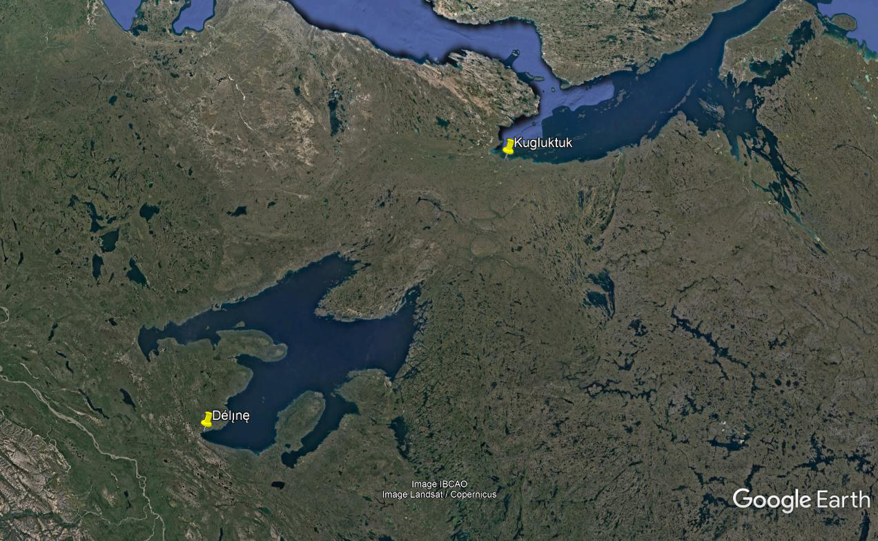

Slide 4
Délı̨nę Governance
Government
Ɂehdzo Got’ı̨nę (RRC)
Elders Council
Caribou Working Group

Slide 5
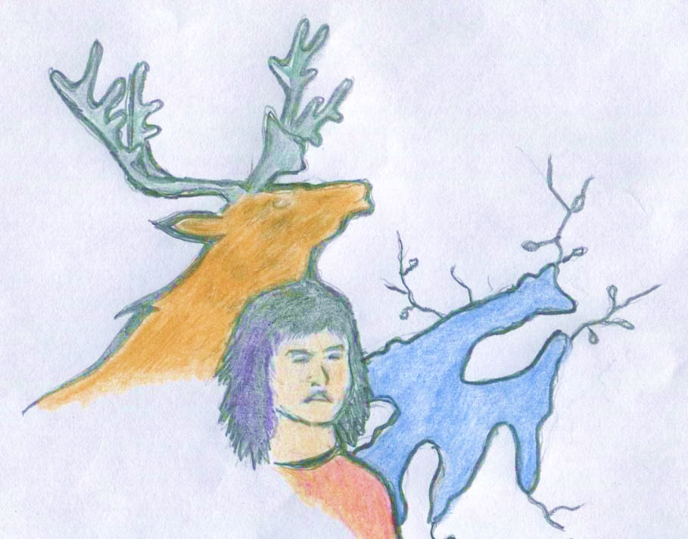
Neregha Ɂekwę́ Abundance
ACCWM, November 2019
Délı̨nę Got’ı̨nę have not been seeing much
Concerns about lack of availability
No concerns about pregnancy rates
Food hard to get at and chafing from ice crust on snow in April
No observations regarding predators

Slide 6
Harvest Regulation for Nı̨regha Ɂekwę́
Different approaches for different regions
Community plans can be an alternative to TAH
Male only harvest may impact herd and community spiritual practices
Emphasis on alternative harvest for food security

Slide 7
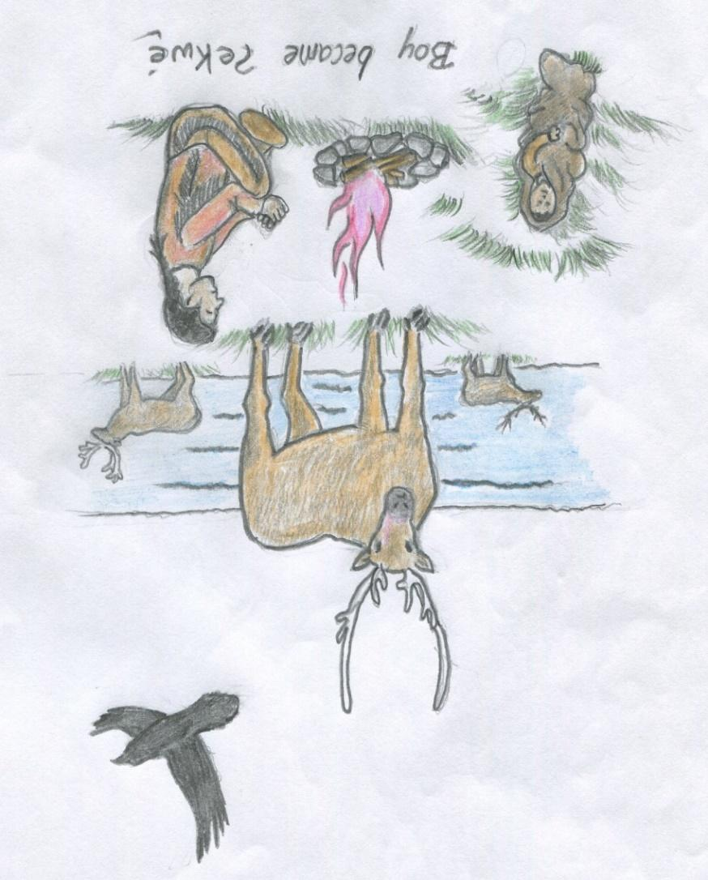
Dene Náowerǝ́ (Knowledge) and Principles
“So much has changed the way we harvest today, and it is today that we bring forth the way our people have lived with the wildlife, the way our grand parents shared on our land. For thousands of years, they lived and shared on the land without interfering in the natural cycles of the land, without changing the ecosystems, without wiping out species and yet we are challenged today to follow their example.”

Slide 8
Principles
Harvest only what the land and water provides or makes available.
Harvest and hunt like your Grandfathers and Grandmothers.
Respect all wildlife, land and water.
Sharing has been the basic common action an individual does when they harvest wildlife, to give so that you in turn receive.
Celebrate and give thanks to those people that contribute in a significant way to our Dene conservation.

Slide 9
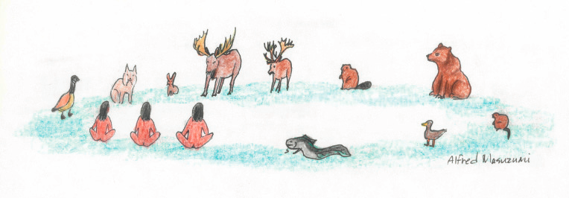
Approaches
Harvester gatherings
Be out there on the land
Cycle of harvesting
Follow the visions of our four grandfathers

Slide 10
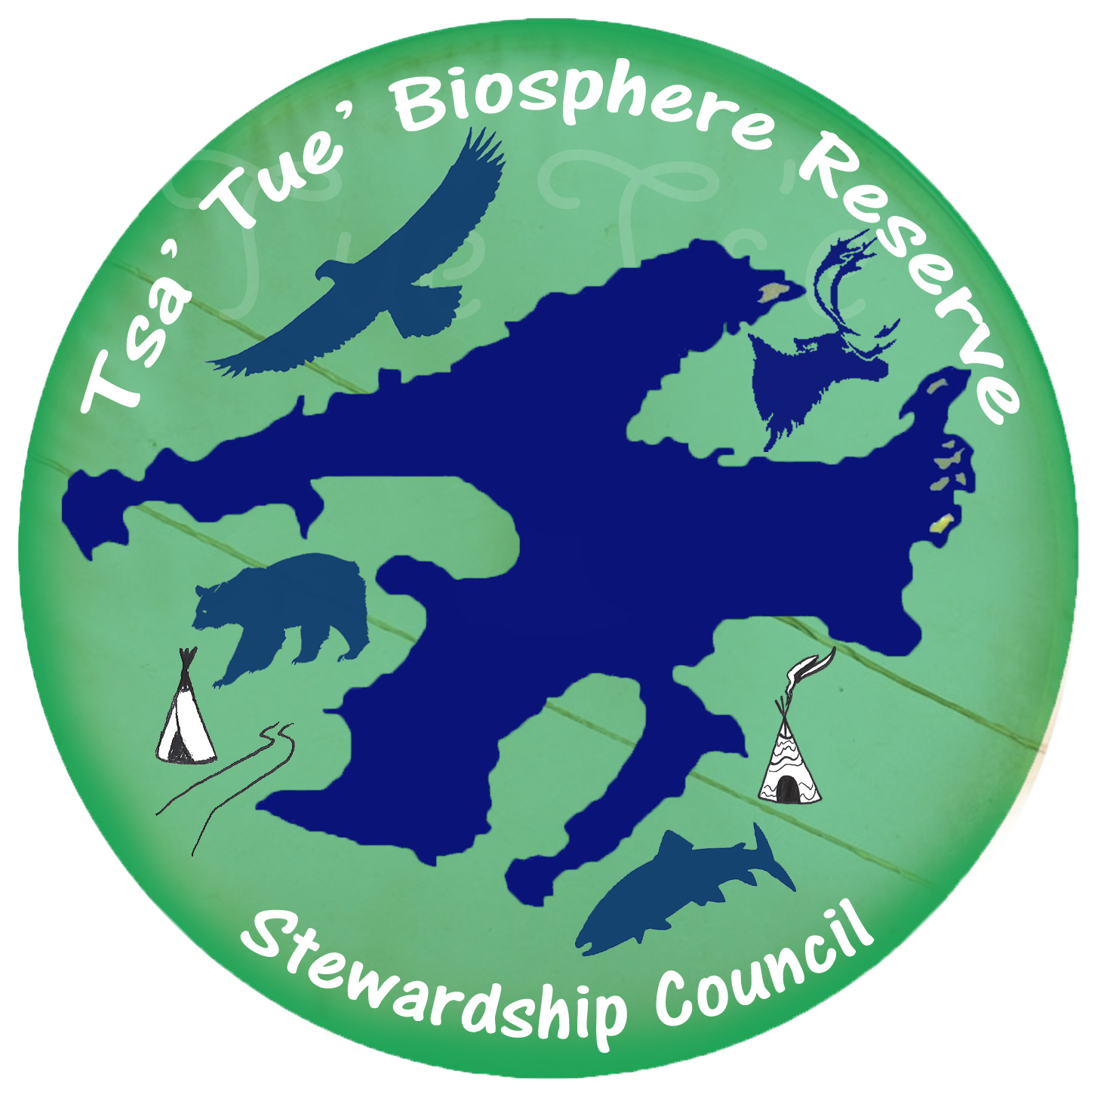


Frameworks for Conservation
Tsá Túé Biosphere Reserve
Indigenous Protected and Conserved Area
Sahtú Land Use Plan
ACCWM (Advisory Committee for Cooperation on Wildlife Management)

Slide 11
Moving Forward: Rebuilding Relationships

Slide 12
Máhsı cho!
Délı̨nę Got’ı̨nę Government
Délı̨nę Ɂehdzo Got’ı̨nę (Renewable Resources Council
  Walter Bezha
  Michael Neyelle
  Edward Reeves

