Slide 1

Nunavut Wildlife
Research Trust and Studies Fund
March 2015

Slide 2
Nunavut Wildlife Research Trust
The NWRT was created to fund wildlife research conducted by territorial and federal government departments.
The NWRT provides an annual allocation to address wildlife management and research priorities as identified by the NWMB and each of the three Regional Wildlife Organizations.

Slide 3
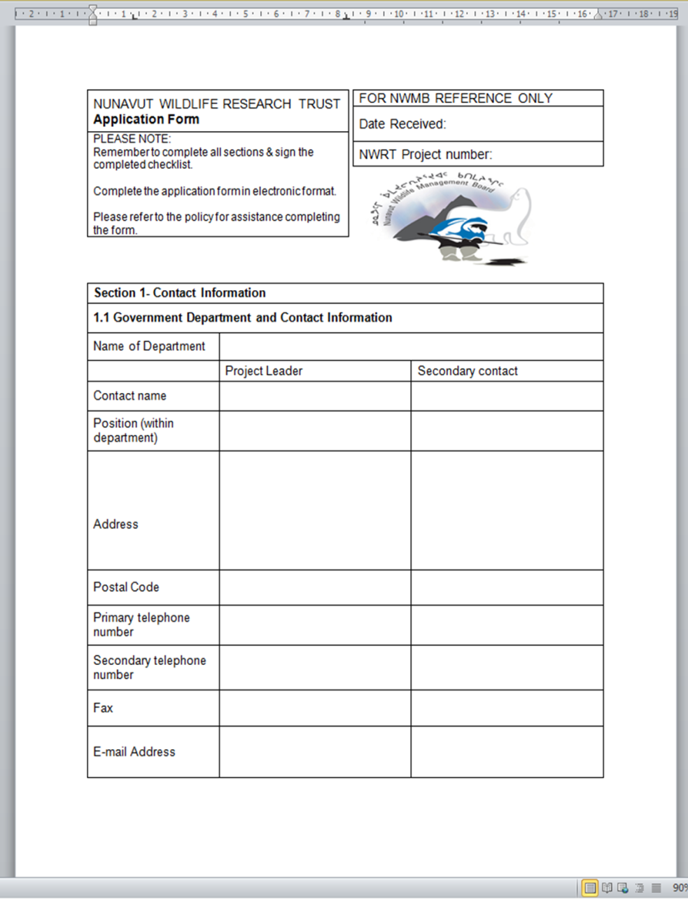
NWRT Application
Application deadline January 15 each year
Application form available on the NWMB’s website and distributed to government departments
Notes:
The NWMB issues a call for proposals each year to government departments by October 1st
The application deadline is January 15 each year. Late proposals will not be accepted.
Proposals will be issued a project number by January 30th, applicants will be informed of this number and are required to use it in all future correspondence.
To give some explanation as to why this is important:
Currently tracking final reports from 2011-2012 projects, funding conditions for 2012-2013 projects, and working on call for applications for 2013-2014 projects for both NWRT and NWSF
Result? Over 50 potential projects each file may pertain to
Understand funding is from multiple sources, all have different requirements but will streamline administration of the funding and prevent confusion.
Extremely difficult to sort through 6 layers of emails and attachments based on departmental research permit numbers to try and figure out which pieces of the puzzle go together and which project they apply to.

Slide 4
NWRT Funding Guide
A funding guide is available to assist applicants with applying to the NWRT, and also to be more transparent pertaining to the requirements and purpose of the NWRT.
  NOTE: NWRT Funding Guide was updated in June 2014

Slide 5
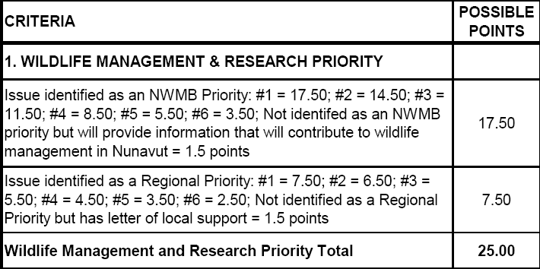
NWRT Scoring Structure: NWMB and Regional Priorities
NWRT scoring gives higher priority to research focused on NWMB and Regional Priorities.
Notes:
Research proposals have a better chance of being funded if they directly address the identified NWMB and regional wildlife management and research priorities
NWMB priorities are based on roles and responsibilities of NWMB as set out in the s. 5.2.33 and 5.2.34 of the NLCA
Regional priorities identified through workshops held in conjunction with RWO AGMs every three years (next is Fall 2013)
List of current priorities sent out with call for applications each year, have copies here if needed
Please clearly identify how the project will address one of these priorities

Slide 6
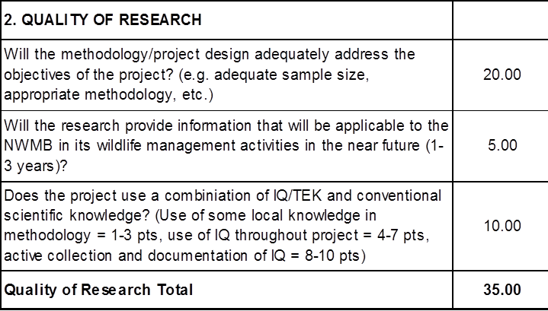
NWRT Scoring Structure: Quality of Research
Projects are awarded more points for research that will be applicable in the near future and that includes Inuit Qaujimajatuqangit/Traditional Ecological Knowledge.
Notes:
Important to include information related to all aspects of study design – not just field methods.
Lots of detail provided on field methods, and a clear objective – such as obtaining a population estimate, but no information provided on statistical analyses, modeling, validation.
Purpose of requesting this isn’t to challenge or refute a proposed approach, but we need to see that there’s been foresight, planning, for all stages of the project as it relates to the objective, schedule, and budget.
The NWMB encourages the use of available Inuit Qaujimajatuqangit in research
Recognize that a lot of projects now incorporate input from local HTOs and other community members in designing studies – such as timing, locations for surveys, and in including community members as observers, guides, and other essential field personnel
In many cases, knowledge holders may also be able to inform a researcher on the background of a particular issue in wildlife management over much longer time frames than past scientific studies can.

Slide 7
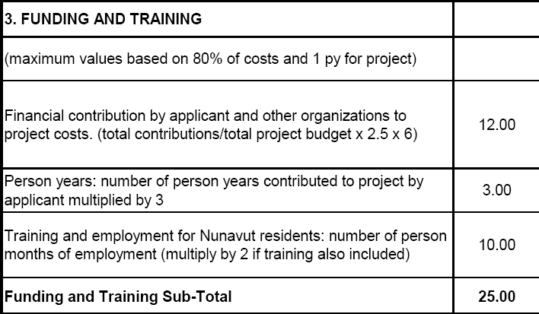
NWRT Scoring Structure: Financial Contributions
Financial contributions by the applicant and other organizations are combined.
Notes:
Applicants receive up to 12 points based on the identification of financial contributions from other organizations
Confirmation of funding from these sources is therefore a standard condition on receiving the funding from the NWRT
For funding provided from within a department, an email from the Director of Research confirming the Department’s allocation of funds is sufficient
For external funding, we have the same expectations as other funding agencies – a copy of the funding notification letter
If not all funds are received, it doesn’t mean NWRT funding won’t come through – just need to indicate if and how reduced funding will impact the project (fewer field days, less equipment, etc.)
Similarly, if more funding than anticipated comes through, indicate how the study design or methods may be enhanced.
Need to confirm that that funds are available to allow the project to proceed as expected, and to inform us if we should expect a modified approach in the progress and financial reports
The NWRT will not fund budget items that do not directly support a proposed research project, such as equipment purchase, salaries, maintenance cost of equipment, administration fees and infrastructure costs.
There are also points awarded for time commitments by the applicant, and for training and employment opportunities for Nunavut residents.
Have had problems in the past couple of years with applications providing conflicting information on the amount of training and employment provided to residents.

Slide 8
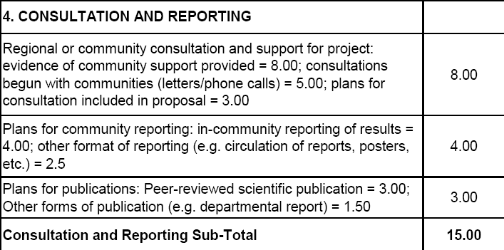
NWRT Scoring Structure: Consultation and Reporting
Applicants are required to provide a letter of support from communities or demonstrate conscientious consultation in their proposals.
Notes:
NWMB anticipates that most research will be done with the cooperation and active participation of local people.
Ideally proponents should obtain support from relevant HTOs or RWOs if more than 5 communities are affected prior to applying for NWMB funds
Recognize that this isn’t always possible, but expect that at least minimum written contact has been made with all affected communities by the time of application.
We’ve noticed in recent years that a lot of applicants had indicted that initial contact had been made with HTOs, or that support had been provided, but didn’t provide any evidence of this. To obtain full points for consultation, evidence of community support has to be provided with the application.
Obtaining these letters of support are a standard condition for all NWRT funding.
Discussion in the past on using GN research permits in lieu of letters of support, but my understanding is that to get a research permit, HTOs are notified and if there are no concerns expressed within a given time frame that it is considered consent.
Understand the practicality of doing this, but the GN and NWMB have different minimum standards for consultation– the NWMB is an organization founded under the NLCA and needs to ensure that meaningful consultation has occurred
I should also note that the NWMB needs current letters of support – in recent years have had some letters dated three years ago. It is possible, and has happened, that a community initially provides support for a project but after a year or two of research has concerns with the methods, or lack of reporting, and doesn’t wish to provide their support for future years of the work.
Also understand that you can’t force HTOs or RWOs to provide a letter of support – which is why the alternative of providing evidence of conscientious consultation is available.
Definition provided in funding guide, but essentially need a list of dates and descriptions of communications sent to communities
NWMB expects that departments will report the results of their work to local communities
Additional points are available if the applicant has plans in place to publish the results of the study

Slide 9
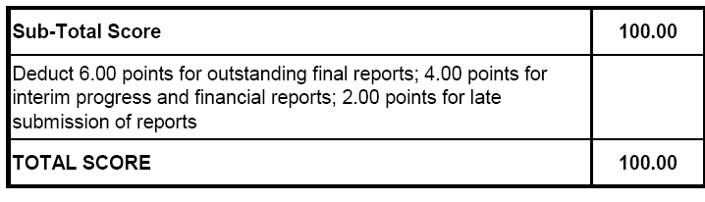
NWRT Scoring Structure: Deductions
The scoring system deducts points for outstanding and late reporting.
Notes:
Failure to submit required reports, and submitting reports late has been an ongoing issue
Project leaders with late or outstanding reports will be penalized for not adhering to the NWRT’s reporting requirements.
6 points for each outstanding final project report
4 points for each outstanding interim progress and financial report
2 points for each report submitted late
Upwards of 20% of total scores have been deducted as a result of outstanding reports
Deductions remain for outstanding reports until the NWMB receives them
Late submission deductions apply for one year

Slide 10
Reporting Requirements
Deadlines for Reporting are:
  Interim project report = 15 January
  Interim financial report = 15 January
  Final financial report = 30 June
  Final project report = 30 September
Requests for extensions for reporting will be considered on a case by case basis but must be made 2 weeks in advance of the deadline
Notes:
Deadline for reports:
Interim project report = 15 January
Interim financial report = 15 January
Final financial report = 30 June
Final project report = 30 September
Requests for extension can be made 2 weeks in advance.
If an extension is received there will be no penalties for late reports, so long as the agreed upon revised deadline is met
Details on the required information and formatting for each report are provided in the NWRT funding guide
The final project report should also include a report by one or more Inuit participants (if applicable) on the operations and results of the project. If these participants choose not to provide a report, evidence should be provided that the opportunity to
do so was available. A template report, with example questions for discussion is attached as Appendix I to this guide.
All reports have to clearly indicate the NWRT project number when they are submitted

Slide 11
Consultation Requirements
Projects that affect less than five communities require a letter of support from each of the affected HTO(s).
Projects that affect more than five communities require a letter of support from the affected RWO(s).
All proponents must have made at least initial written contact with the relevant HTO(s)/RWO(s) prior to submitting a proposal to the NWMB.
  A copy of these initial contact letters must be included with a proposal if the project is to be considered for funding.
If a letter of support is not submitted, applicants must demonstrate that they have done a conscientious job of consulting the relevant HTO(s)/RWO(s).

Slide 12
Funding Limitations and Eligibility
Proposals must score a minimum of 65 points to be considered by the NWMB.
The Board will only consider a package of the top ranked proposals making up not more than 135% of the amount available to allocate.
The Director of Wildlife Management has the authority to reject applications that are not submitted in adequate detail, do not meet the funding guide criteria or minimum score, or where reporting requirements have not been met.
Notes:
Read 1 and 2
Re Points #1 and 2: If there is $600 k available to allocate to new projects in a given year, the proposals scoring at least 65% that can be brought to the Board cannot cumulatively request more than $810 k.
Hard to meet in the past couple of years because of a lack of detail, conflicting information in proposals as previously mentioned
Staff need to be able to pick up a new proposal and understand the methods that will be employed, how the objectives will be achieved, and see that the project lead has given consideration to the schedule, budget, and logistics.
Also need to see evidence of real effort being made to communicate with and involve local communities and report the results.
Read 3

Slide 13
Funding Limitations and Eligibility
At least 50% of the total project budget must be funded by the applicant or other external sources.
Projects that involve the compilation of existing data will not be funded unless this is an integral part of a project which is judged to be necessary in meeting wildlife management and research priorities.
Notes:
Read 1 and 2
Also note that last year we have received 2 and 3 separate applications from the same researcher:
for the same field crews
in the same locations
at the same times
working on different aspects of the ecology of the same species
Understand that it’s important to maximize resources and man power in the field, and will generally encourage it but
The NWMB is not going to consider paying for the same flights, meals, or fuel two or three times over
Please roll it all into one application

Slide 14
Funding Limitations and Eligibility: Multi-year Funding
Limited to 25% of the total amount available for funding.
To be considered, proposals must meet the following four criteria:
  Research Priority = 65%
  Research Quality = 70%
  Funding and Training = 60%
  Consultation and Reporting = 70%
Notes:
Funding for multi-year projects is limited to no more than 25% of the total amount available for funding
If there is $700 k available for allocation, $175 k is available for multiyear allocation
The first demand on this is for multi-year commitments from previous years (those in years 2 and 3 of their work)
All requests for multi-year funding must meet the following four criteria:
Research Priority (65% or 16.25 points / 25)
Research Quality (70% or 24.50 points / 30)
Funding and Training (60% or 15 points / 25)
Consultation and Reporting (70% or 10.50 points / 15)
Proposed multi-year projects will be considered for single year funding if the project does not meet the minimum requirements or if the maximum amount of funding for multi year projects has been met.
Projects receiving multi year finding will be reviewed on an annual basis and are contingent on interim project and interim financial reports

Slide 15
Funding Limitations and Eligibility: Preliminary Funding
Maximum $15,000 per project.
Limited to 10% of the total funding available.
Examples of what would qualify for preliminary study funding;
Consultation on research methods;
consultation to obtain community support;
consultation on level of community involvement and participation in a research project; or
consultation on how to include IQ/TEK in a research project.
Notes:
Maximum $15,000 per project.
Limited to 10% of the total funding available.
Examples of what would qualify for preliminary study funding;
Development of research methods prior to undertaking a research project;
Consultations to obtain community support for a proposed study;
Consideration of opportunities for community involvement and participation in a research project; or
Consultation on how to include IQ/TEK in a research project.
A single project will only be eligible for preliminary study funding once
A project can’t receive preliminary and regular NWRT funding in the same year
NWMB expects that the results obtained while receiving preliminary study funding will lead to the development of a research project in future years

Slide 16
Notification of Funding Decisions
Proposals are reviewed by the Board during the March meeting
Individual applicants and departments will be advised in writing of the NWMB’s funding decisions by mid-April
All funding conditions must be met by 30 June
The NWMB may establish additional funding conditions prior to funding being issued
Notes:
Proposals are reviewed by the Board during the March meeting
Individual applicants and departments will be advised in writing of the NWMB’s funding decisions, including any conditions on funding, by mid-April
All funding conditions must be met by 30 June; there have been issues with this in the past, this year the deadline will be strictly enforced
As per the policy, each department is responsible for submitting confirmation of the funding conditions as a single package. Individual project confirmations will not be accepted.
Requests for extensions to meet funding conditions will be required on a case by case basis but must be made 2 weeks in advance of the June 30 deadline
Once all funding conditions have been met the NWMB will negotiate a Contribution Agreement with the associated government department by August 1st

Slide 17
Nunavut Wildlife Studies Fund
The Nunavut Wildlife Studies Fund (NWSF) was created by the NWMB to fund community-based management and research projects in Nunavut, in particular, projects led by Hunters and Trappers Organizations
Addresses issues of local concern
Very similar structure to NWRT
Notes:
Nunavut Wildlife Studies Fund (NWSF) was created by the NWMB to fund community-based management and research projects in Nunavut, in particular projects led by Hunters and Trappers Organizations.
The NWMB Studies Fund is intended to address wildlife management issues of local concern, and is available only to Nunavut community-based researchers.
The NWSF provides an annual allocation of funds from it’s annual operating budget to encourage Inuit and community-based organizations to undertake and lead research projects that address community needs and concerns related to the management of wildlife in Nunavut.
Very similar structure to NWRT, but:
There is no option for multi-year funding
Maximum amount is $30 k regular funding and $7,500 preliminary study funding
Similar application process, but:
Policy allows NWMB staff to work with potential applicants on developing appropriate methodology and projects budgets
For many applicants, it’s their first time conducting research of filling out a funding application

Slide 18
Nunavut Wildlife Studies Fund
Government researchers can support the Hunters and Trappers Organization with applications and research, however the Hunters and Trappers Organization maintains responsibility for all correspondence with the NWMB and submission of all required documents
Notes:
Read slide
Project lead must be HTO or other community organization
Same reporting requirements as with NWRT, and must be prepared and submitted by the project lead

Slide 19
NWSF Scoring Structure
Scoring structure similar to NWRT with some changes that benefit those without research experience.
  NWMB and Regional Priorities
    More weight given to regional priorities
  Quality of Research
  Financial Contributions
  Consultation and Reporting
Notes:
Priorities and Quality of Research the same as NWRT.
Financial contribution differences: Where the financial contribution is calculated in NWRT for a maximum value of 12 points, a similar calculation is used in NWSF, but only for a maximum of 6 points. The remaining 6 points are given based on a general evaluation of the components of the budget; therefore, less weight is given to the actual percentage of funds that have been committed by other parties.
Consultation and Reporting differences: less of a focus on providing evidence of community support, more focus on simply meeting face-to-face with community organizations and/or the public and; publication criteria are less dependent on peer-review, are aligned with reporting to government departments, schools and community organizations.

